Slide 1
Product Management Deliverable
Ohana Deliverable 5/16
Mikail Patankar
University of Pennsylvania

Slide 2
01
02
Feature Feedback
Bugs & QOL Updates
03
04
Conclusion
Q&A, Feedback & Next Steps
Ohana Deliverable 5/16
Suggestions collected from customer discovery interviews
Potential bugs and quality of life fixes
Summary of key points & future ideas
Notes:
Change this to another timeline slide

Slide 3
01. Feature Feedback
Ohana Deliverable 5/16
Suggestions synthesized from customer discovery interviews

Slide 4
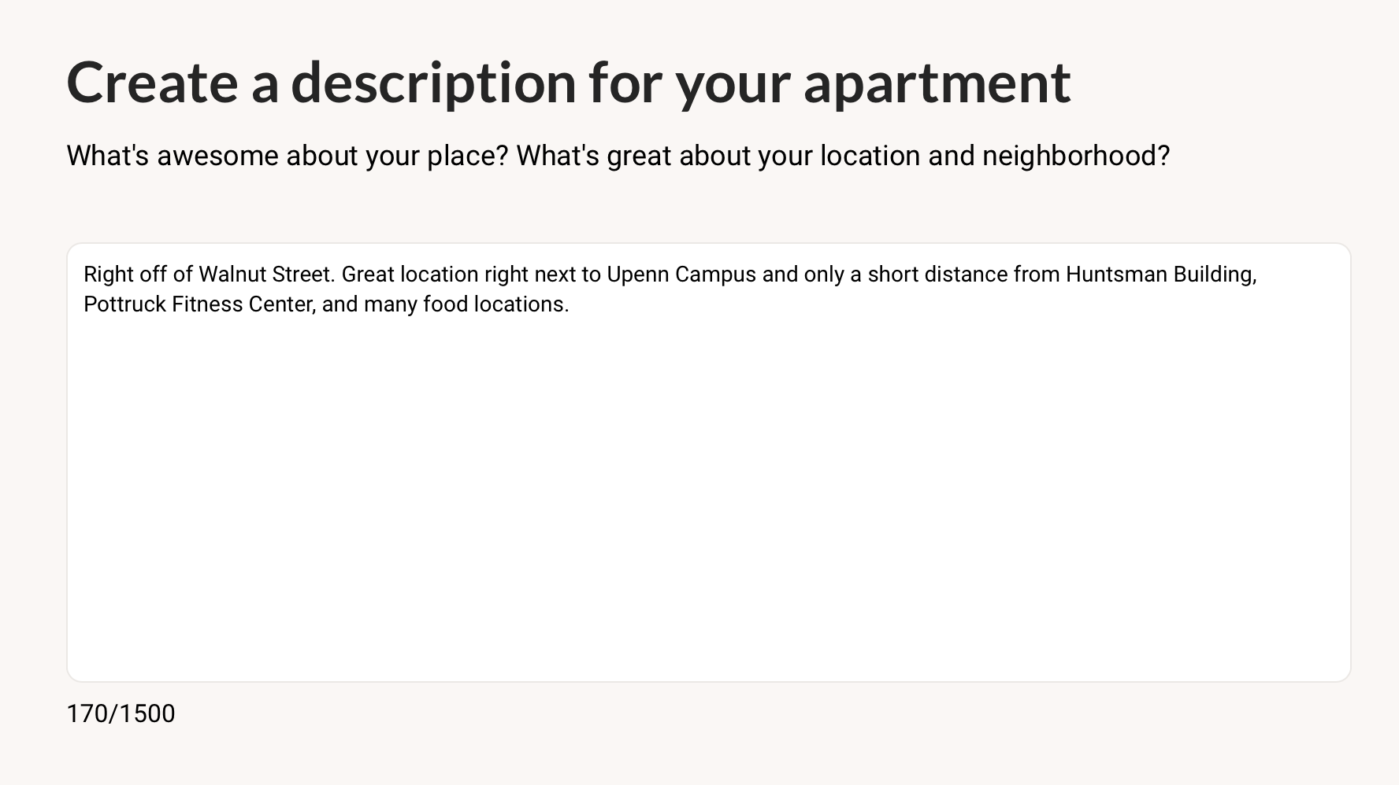
Guiding Questions
Ohana Deliverable 5/16
All customers expressed the need for more guiding questions
Telling a story through your property listing
Example: What are some of your favorite places to eat nearby?
Notes:
They all hit a point when describing their listing where they were just like, what else do I say?

Slide 5
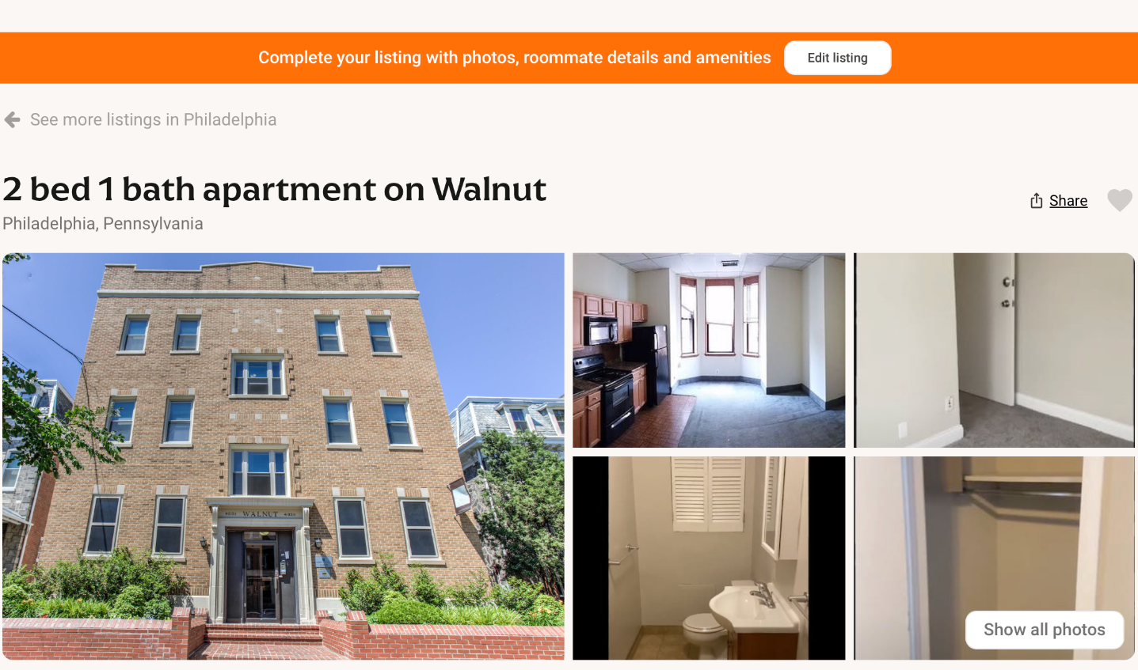
Listing Information
Ohana Deliverable 5/16
None of the customers interviewed noticed the edit listing button
Creating a popup can incentivize customers to click right away
Differentiating necessary vs. secondary information
Notes:
Emphasize that photos were the primary way that kids my age are going to engage, the title slide and photos are pretty much the only thing that matters

Slide 6
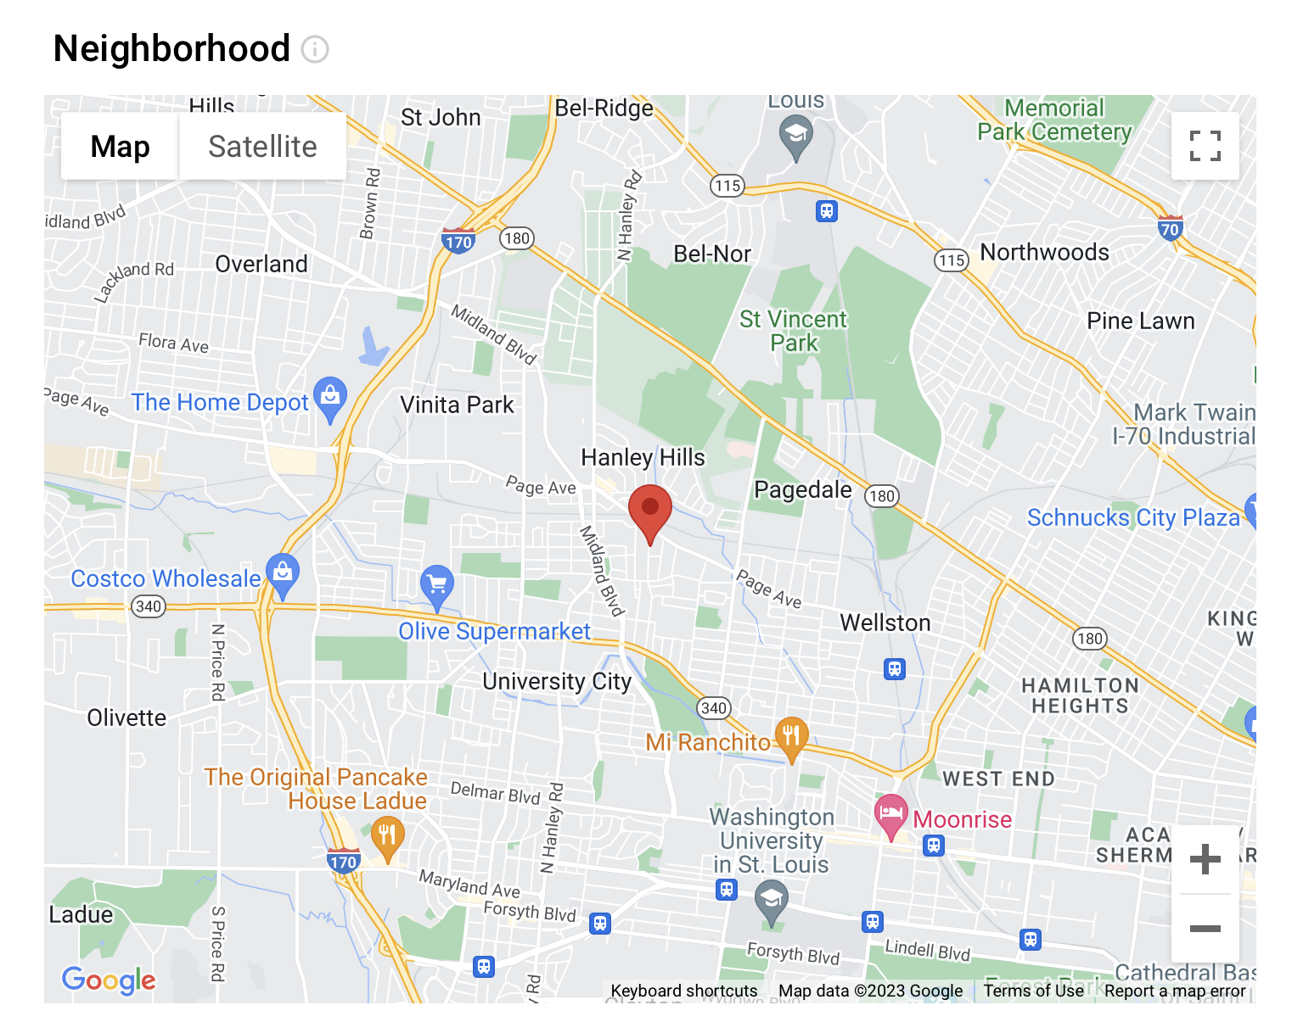
Neighborhood Feature
Ohana Deliverable 5/16
All of the customers were appreciative of the neighborhood/google maps feature when viewing listings
Adding a tag option to properties can help customers sort through information
Ex: University City, Rittenhouse Square, West Philadelphia
Notes:
Say that there is potential to show hotspots of activity, let people know if there is an important shop nearby, ie starbucks, that could be a way to build and expand on the neghborhoods function
Tags envisioned on search part, consumers are primarily concerned with photos, price, and if you can throw tags in there, could be great.
Tag encouragement could be part of the details screen, list common tags for the area they are listing in
Adding tags underneath properties could be a great way to get more information to customers, include it as part of the edit listing section

Slide 7
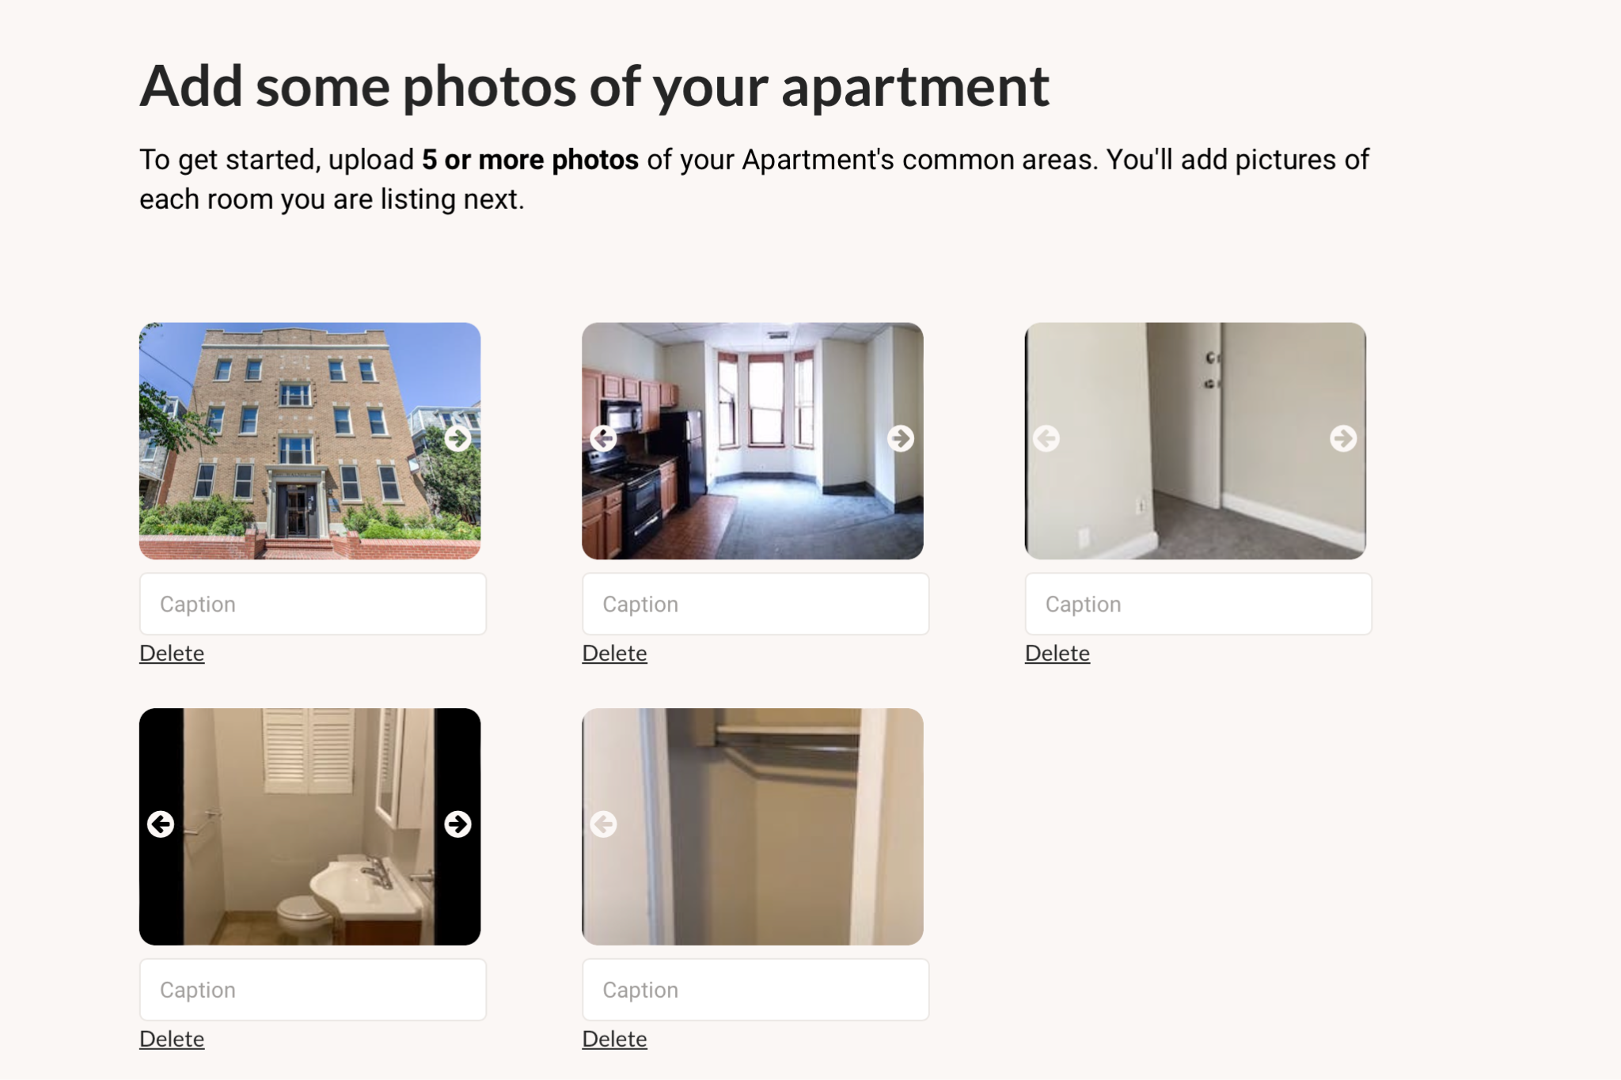
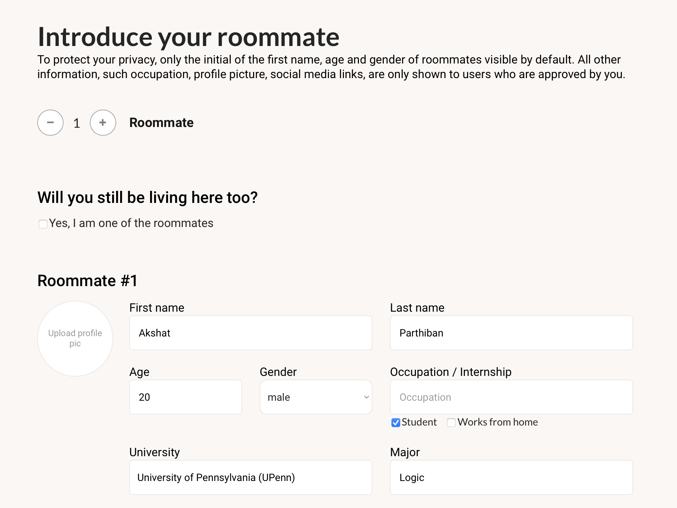
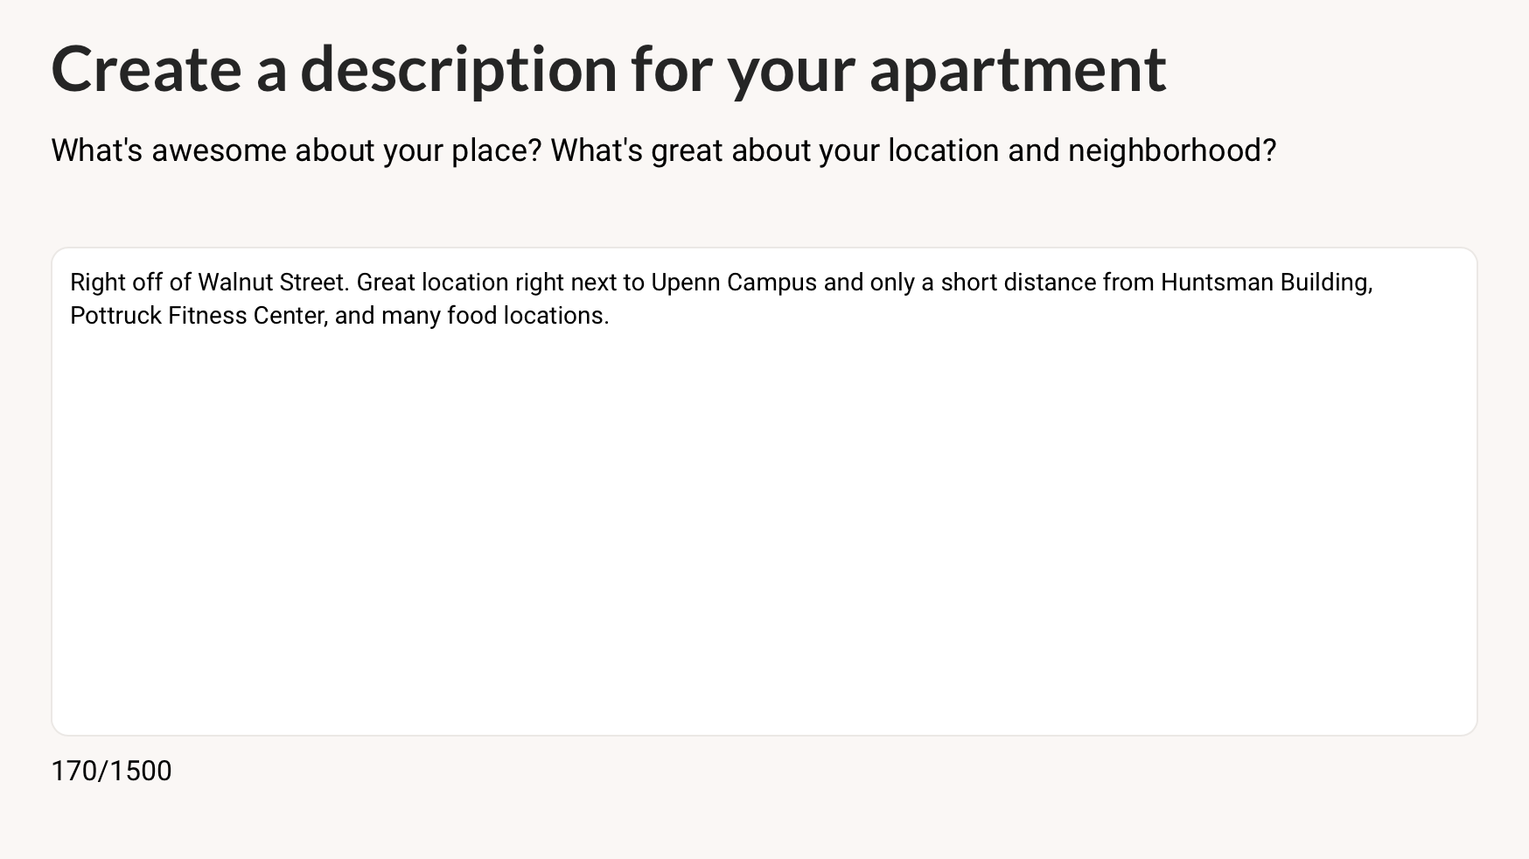
Other Suggestions
Standardized Photo List
Roommate Feature Revisit
Standardized Description Alternative
Ohana Deliverable 5/16
Notes:
Creating a standardized photo list ie: living room, kitchen, front of building, bathroom, another picture of living room
Unease about the roommate feature, including them throughout the process, minimizing information required about roommate
Standardizing the description box could be a great way for customers to get all the information they need.

Slide 8
02. Bugs &
QOL Updates
Ohana Deliverable 5/16
Potential bugs and quality of life fixes

Slide 9
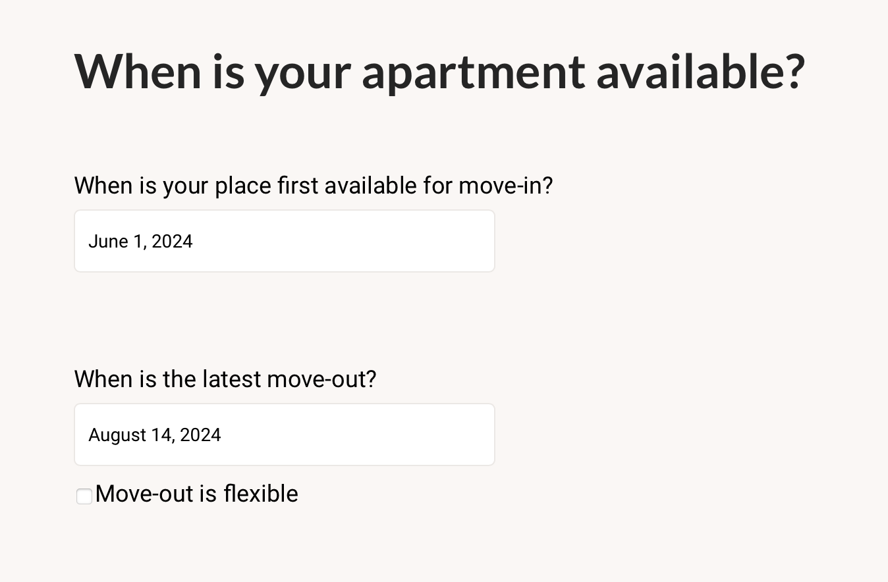
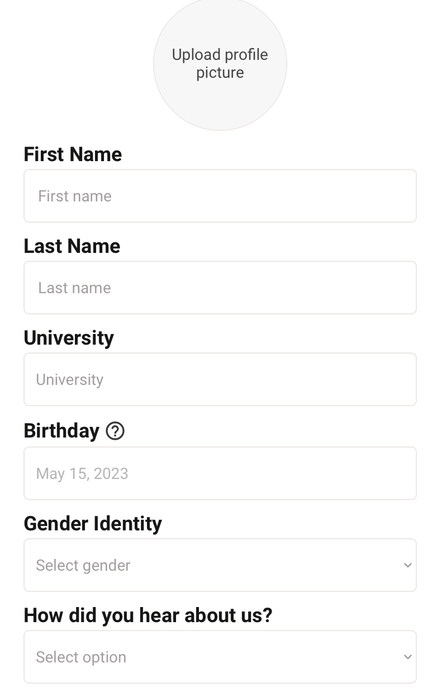
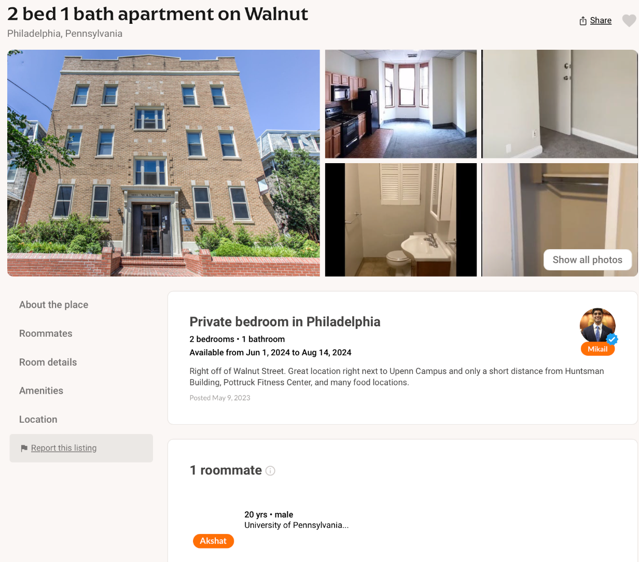
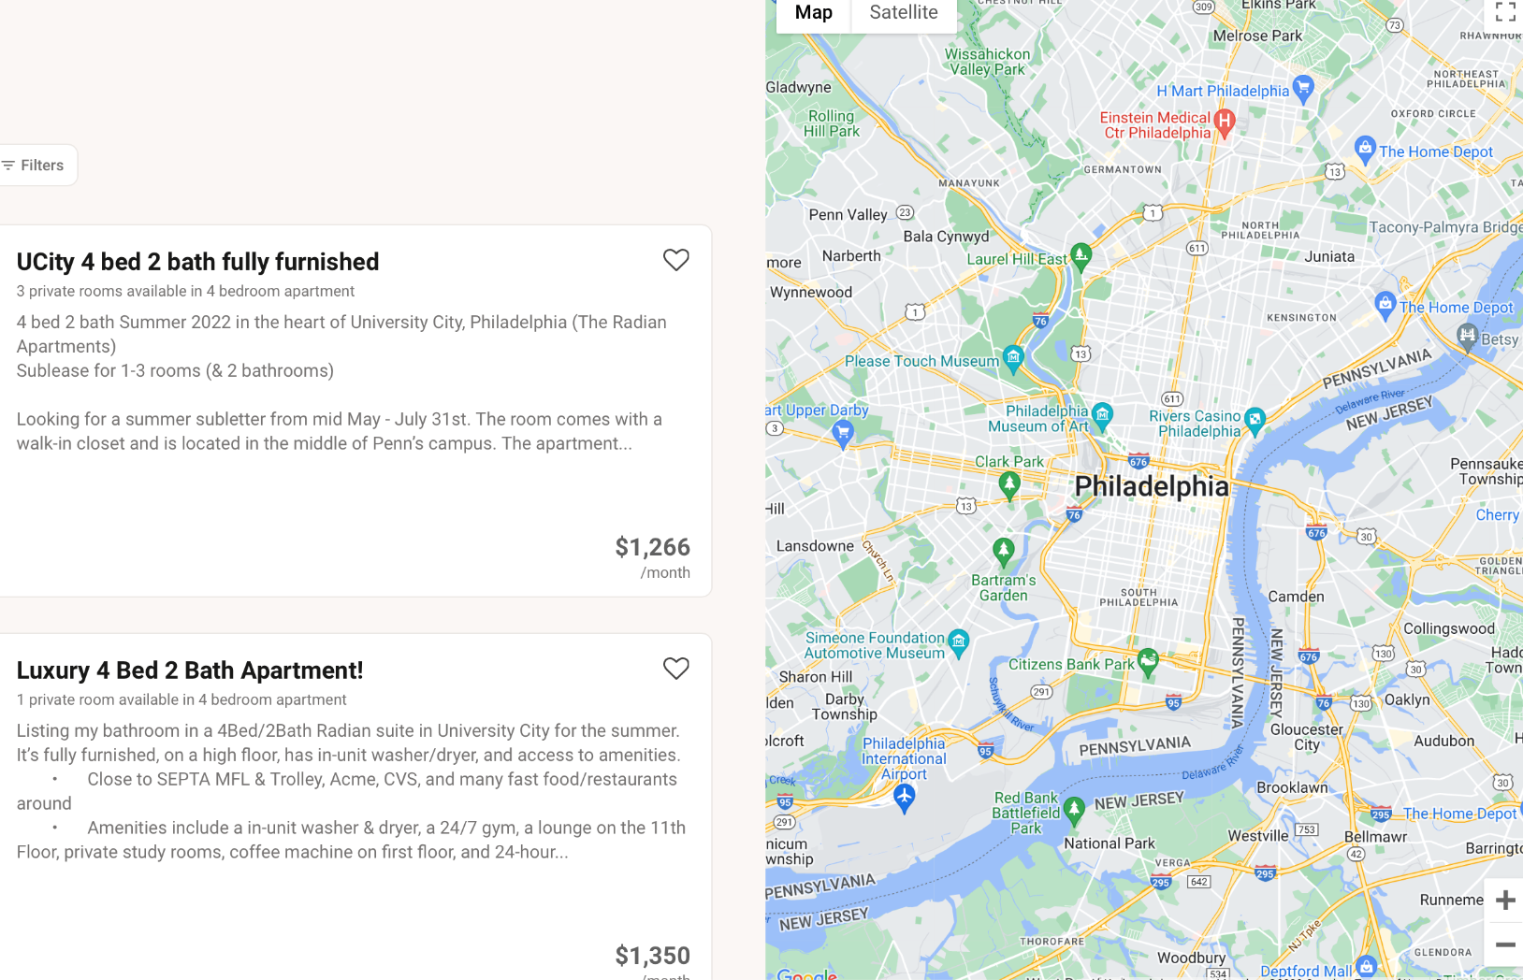
Tweaks & Improvements
1
2
3
4
Listing Dates Fix
Required Fields Indicator On Signup
Capitalization Consistency
Map Adjustment On Listing Screen
Ohana Deliverable 5/16
Notes:
Also if you register with the same email twice, it overrides your account. I just lost my account information.

Slide 10
Conclusion &
Next Steps
Ohana Deliverable 5/16

Slide 11
Summary
Ohana Deliverable 5/16
Feature Updates
Other Suggestions
Customer Guidance, Necessary Information, Neighborhood Capitalization.
Standardization, Roommate Revisit, Storytelling Guidance
QOL Changes
Future Initiatives
Listing Dates, Requirements, Capitalization & Formatting, Map Adjustment
Mobile App, Localization Opportunities, Listing Promotions

Slide 12
Thanks!
Ohana Deliverable 5/16
Do you have any questions?

